Slide 1
Stock portfolio performance
ECON 3105 - Big Data Analytics
Group 8 - Feliz LUBERNE 22508775

Slide 2
“In the stock market, you have two choices: get rich slowly or get poor quickly.”
— Benjamin GRAHAM

Slide 3
Table of contents
1
3
2
4
0
Introduction
Data handling and analysis
Research Question
The corresponding results

Slide 4
Data set informations
1
Data set Characteristics: | Multivariate | Number of Instances: | 315 | Area: | Business
Attribute Characteristics: | Real | Number of attributes: | 12 | Data Donated: | 22 April, 2016
Associated Tasks: | Regression | Missing Values: | N/A | Number of Web Hits: | 103978
Data : Stock portfolio management

Slide 5
Overview - Stock portfolio performances
1
Weighted scoring stock selection models have three disadvantages:
They cannot identify the relations between weights of stock-picking concepts and performances of portfolios.
They cannot systematically discover the optimal combination for weights of concepts to optimize the performances.
They are unable to meet various investors’ preferences.
This study aims to construct weighted scoring stock selection models more efficiently to overcome these disadvantages.
The weights of stock-picking concepts in a weighted scoring stock selection model can be regarded as components in a mixture.
The simplex centroid mixture design is used to obtain the experimental sets of weights.
These sets of weights are simulated with US stock market historical data to obtain their performances.

Slide 6
Research question
Which investment portfolio is the safest, over the training period, combining the ratio of risk taken & profit recovered?
2
It addresses an important aspect of investing:
The ratio of risk taken and profit recovered is a key metric for evaluating the performance of an investment portfolio.
Identifying the safest investment portfolio is important for investors who are looking to minimize their risk exposure while still earning a reasonable return on their investment.
By focusing on the training period, we can evaluate the performance of different investment portfolios under different market conditions.
By identifying the safest investment portfolio, we can help investors make more informed decisions about where to allocate their capital, which can lead to better long-term outcomes.

Slide 7
Data Handling - cleaning & formatting
3
df = pd.read_excel('file.xlsx', sheet_name='all period', skiprows=1)
Head of the data
df.head()
 | Unnamed: 0 | The weight of the stock-picking concept | Unnamed: 2 | … | Unnamed: 17 | Unnamed: 18
0 | ID | Large B/P | Large ROE | … | Abs. Win Rate | Rel. Win Rate
1 | 1 | 1 | 0 | … | 0.52 | 0.411765
2 | 2 | 0 | 1 | … | 0.52 | 0.764706
3 | 3 | 0 | 0 | … | 0.44 | 0.376471
4 | 4 | 0 | 0 | … | 0.36 | 0.270588
0 | ID | Large B/P | Large ROE | … | Abs. Win Rate | Rel. Win Rate
0 | 1 | 1 | 0 | … | 0.52 | 0.411765
1 | 2 | 0 | 1 | … | 0.52 | 0.764706
2 | 3 | 0 | 0 | … | 0.44 | 0.376471
3 | 4 | 0 | 0 | … | 0.36 | 0.270588
4 | 5 | 0 | 0 | … | 0.72 | 0.447059

Slide 8


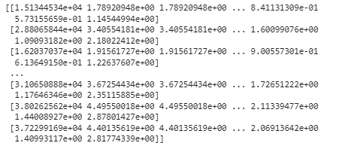
News
To Big to be shown
3
Covariance Matrix
Covariance Matrix’s Diagonal
Volatitlity
Systematic Risk

Slide 9
Data Handling - cleaning & formatting
3
Data Handling
Sharpe Ratio
0 | 0.798658
1 | 1.138889
2 | 1.062500
3 | 0.527778
4 | 0.873563
… | …
58 | 1.510000
59 | 1.528736
60 | 1.307692
61 | 1.500000
62 | 1.610526
This sharp ratio will help us with the visualisation part.

Slide 10
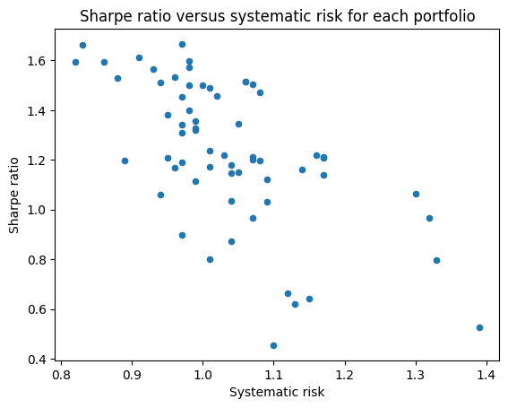
Sharpe Ratio against systematic risk
3
The scatter plot opposite shows the Sharpe ratio versus systematic risk for each portfolio. The Sharpe ratio measures risk-adjusted return, while systematic risk measures the risk inherent in a portfolio.
Data points are represented by blue circles, with the highest concentration of points in the top left-hand corner. The highest Sharpe ratio is around 1.6 and the lowest is around 0.4. The highest systematic risk is around 1.4 and the lowest is around 0.8.
Ymax & Ymin =The maximum and minimum sharpe ratio limits, indicating the sharpe ratio box.
Notes:
The Sharpe ratio is a measure of a portfolio's risk-adjusted return. The higher the Sharpe ratio, the better the portfolio. The highest Sharpe ratio in the chart is around 1.6, meaning that this portfolio has a high return relative to its risk. The lowest Sharpe ratio is around 0.4, meaning that this portfolio has a low return relative to its risk.
Systematic risk measures the risk inherent in a portfolio. The highest systematic risk in the chart is around 1.4, which means that this portfolio has a high risk. The lowest systematic risk is around 0.8, meaning that this portfolio has low risk.

Slide 11

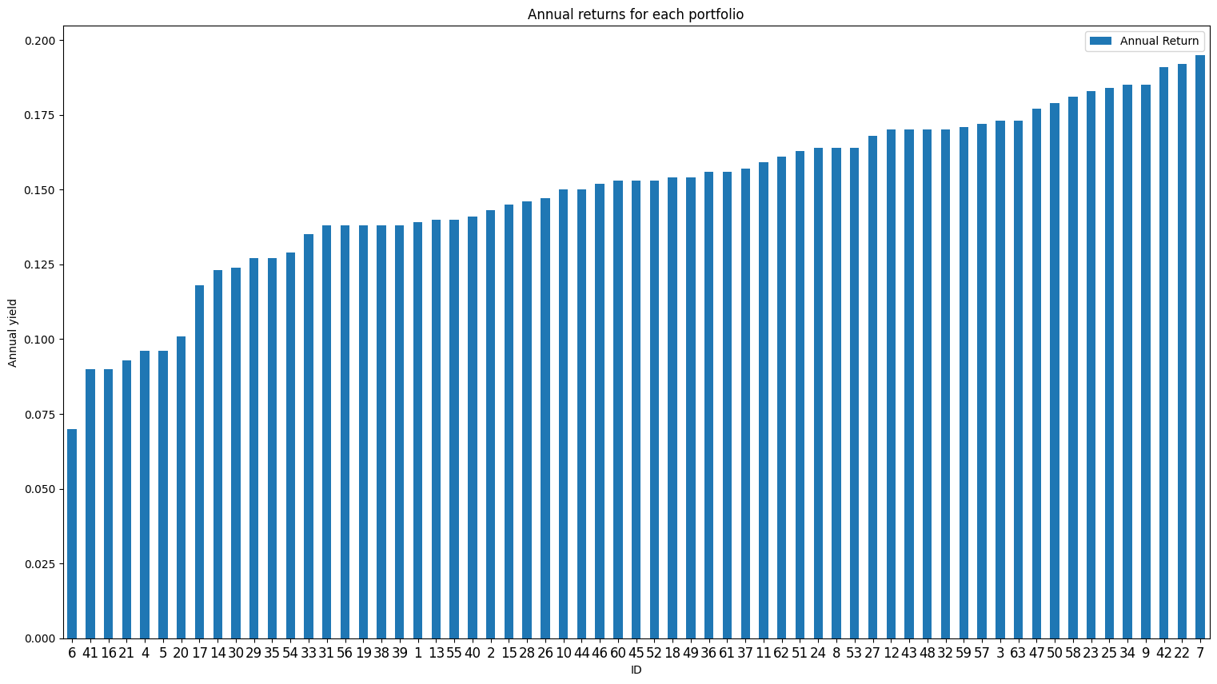
Sharpe Ratio Utility
3
Xmin = lowest annual return in the 63 portfolios
Xmax = Highest annual return in the 63 portfolios
!
Having the maximal annual return, doesn’t mean that you have the best portfolio
Notes:
The bar chart above shows the annual returns for each portfolio. The bars are blue in color and increase in height from left to right, meaning that annual returns have increased over time. The highest bar is at 9.222 on the x-axis and has a height of around 0.215 on the y-axis, meaning that the associated portfolio has the highest annual return. The lowest bar is 4.16224 on the x-axis and has a height of around 0.075 on the y-axis, meaning that the associated portfolio has the lowest annual return.

Slide 12
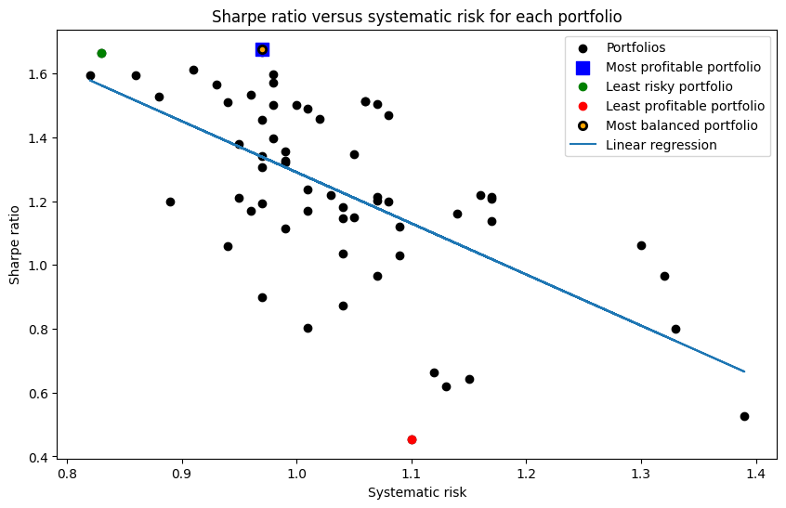
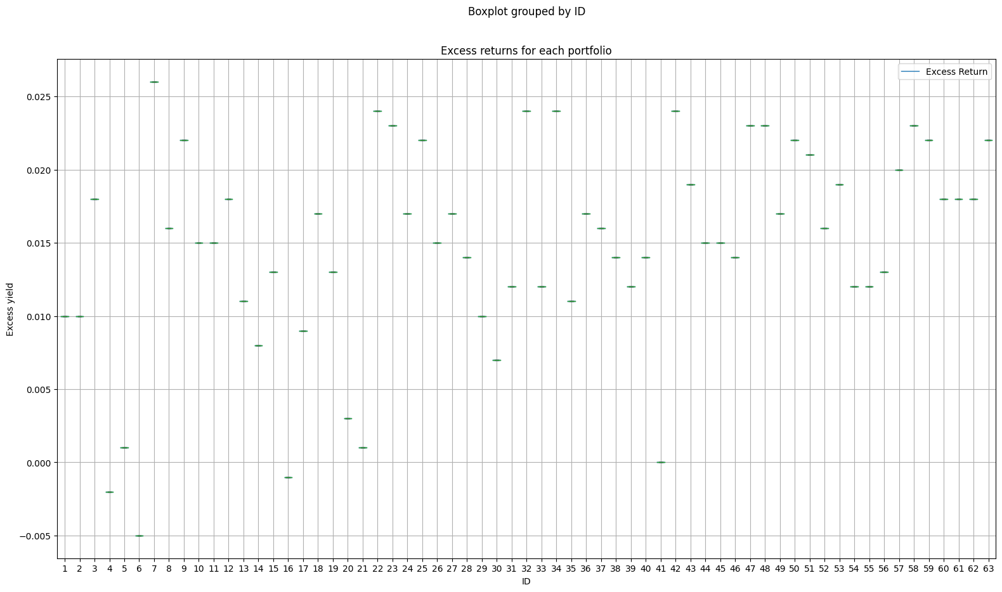
Sharpe Ratio Utility
3
The graph above shows a mixture of the three graphs above, with the "best" portfolio visible.
But is it really the best portfolio?

Slide 13
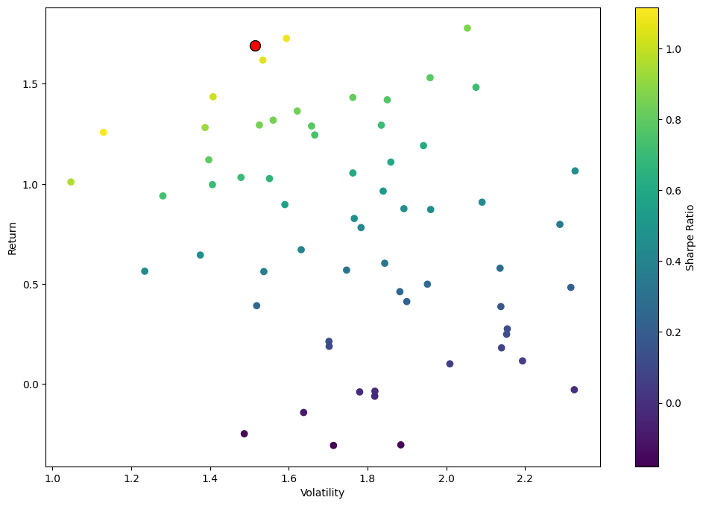
Conclusion
3
The red dot on the graph represents the optimal portfolio with the highest Sharpe ratio. This portfolio has a volatility of around 1.8 and a return of around 1.5.
However, it is important to note that volatility and return are not the only factors to consider when determining which portfolio is the safest. Other factors such as diversification, liquidity and investment duration must also be taken into account.

